Slide 1

Session 1: Electrical

Slide 2
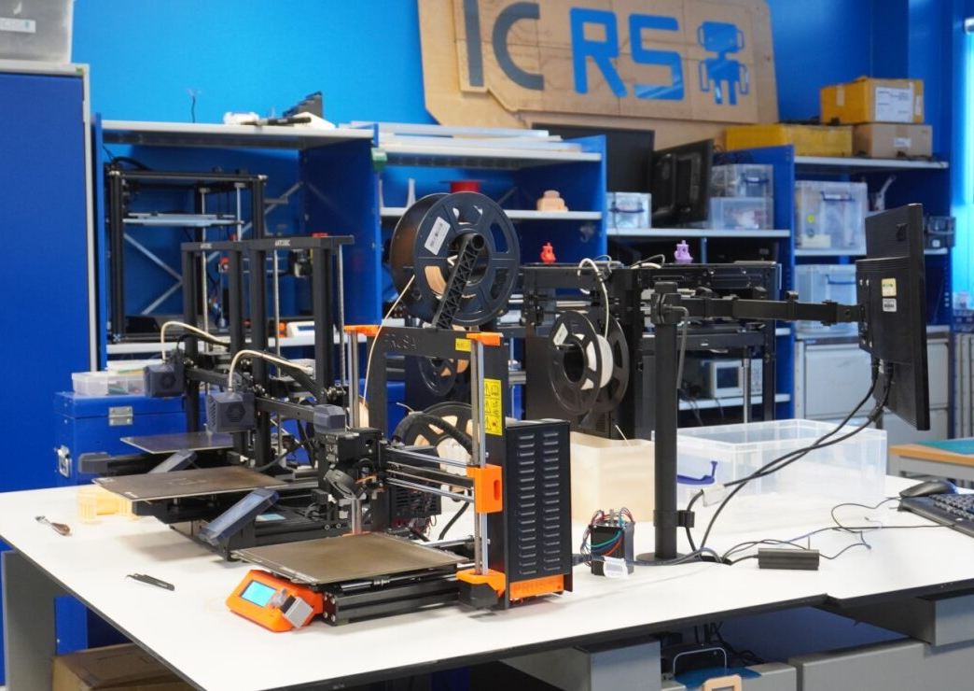
What is ICRS?
Makerspace
Community
Projects

Slide 3
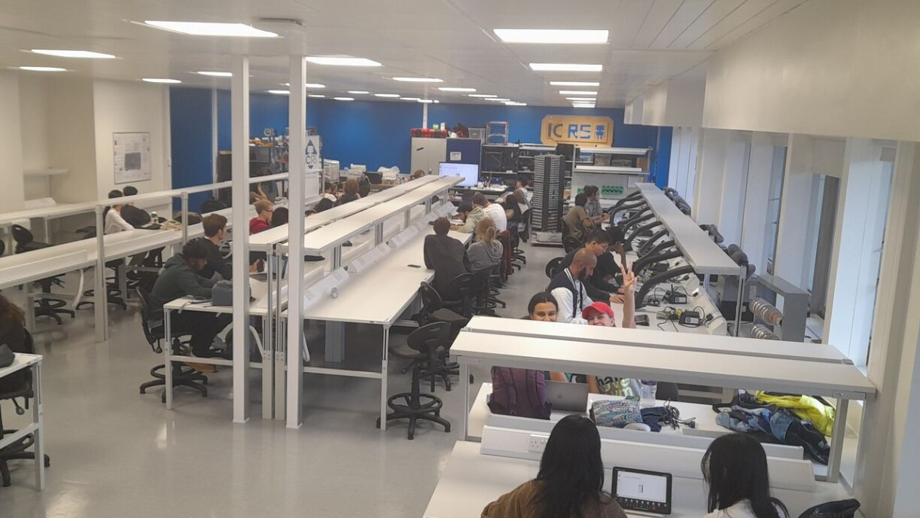
What is Robotics 101?
Introductory course covering the basics for building a simple robot
Electronics, Hardware, Software
Small Competition at the end
Foundation for future projects

Slide 4
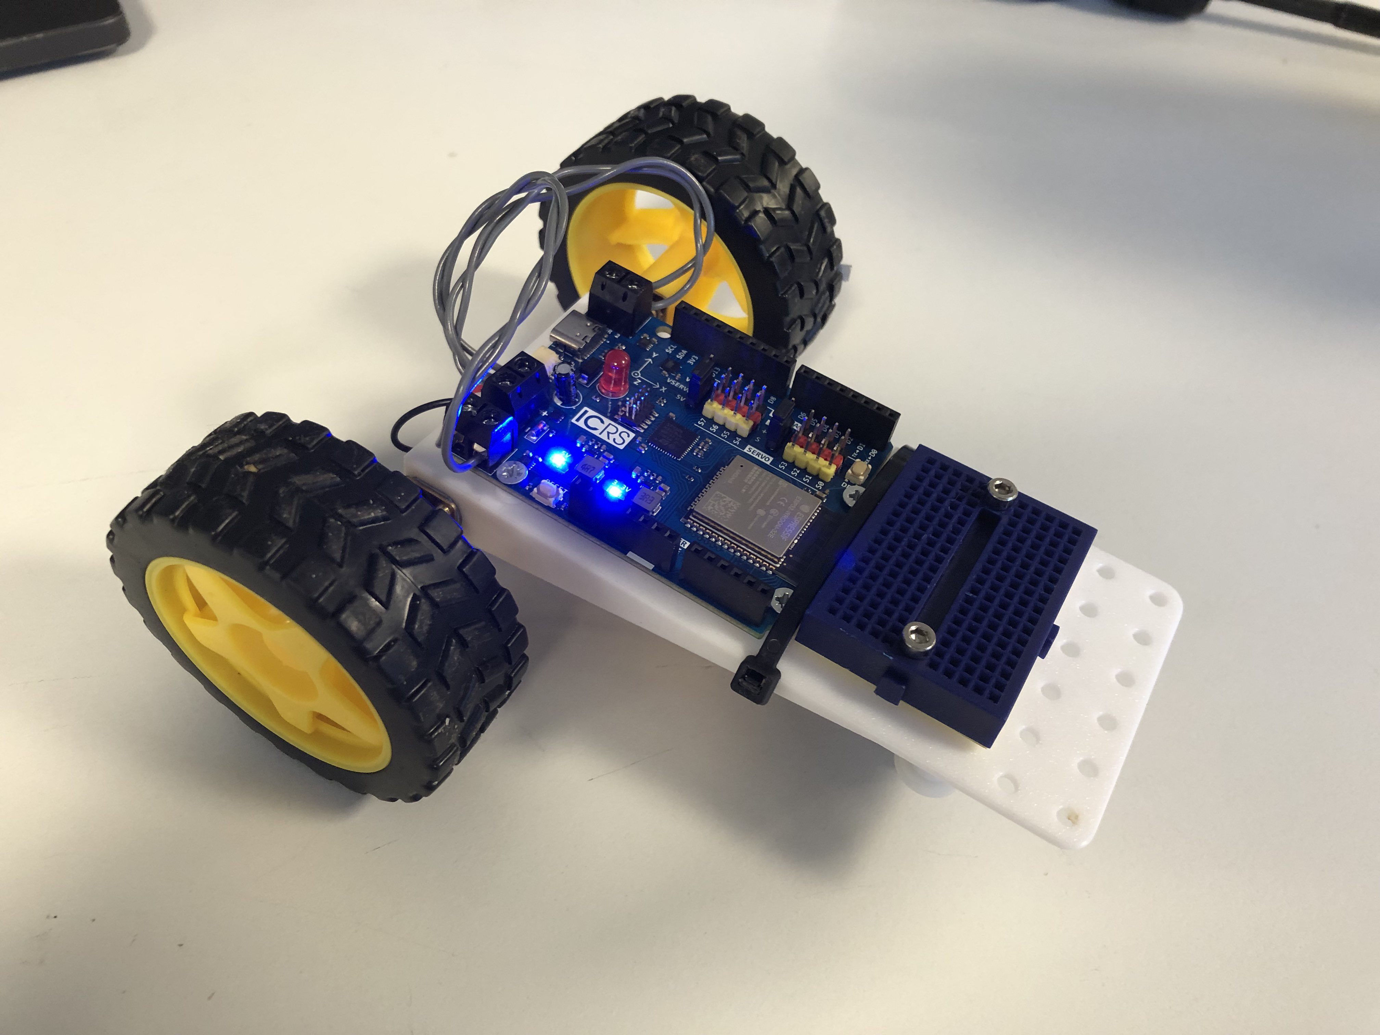
Goals
Build robot
Remote control
Move around
Able to race
Gain basic skills to be able to join society projects and make your own projects come to life.

Slide 5
Session Plan
Session 1: Electrical theory & Soldering
Session 2: Mechanical design & robot assembly
Session 3: Software
Potential Session 4: Testing, debugging and competition?

Slide 6

Session 1: Electrical & Soldering
In a few minutes we will split into groups of 3-4
First 45mins: longer introduction & some electronics theory
Rest of the session: soldering
Talk from Ocado from 6pm to 8pm, there will be FREE PIZZA

Slide 7

Make groups!
You can make your own groups or come to the front and we will put you in groups.
Once you have a group, collect one numbered bag of components per group.
Feel free to come up with a team name and write it on the bag.

Slide 8
Projects run throughout the year
Eurobot
SSL
Ornithopter
Delivery robot

Slide 9
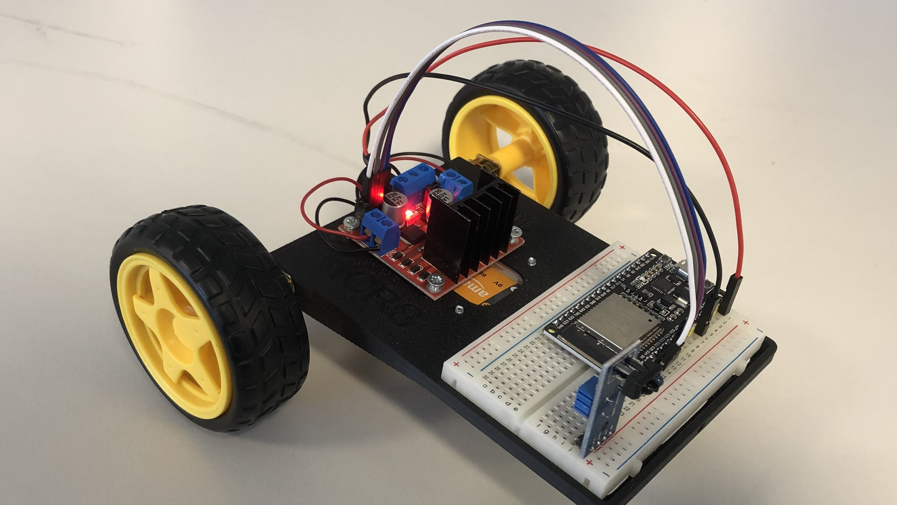
Finished 101 Robot

Slide 10
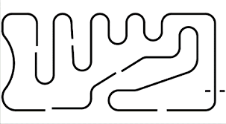
Line following robot
First term next year
Challenge is to build a robot to follow a line down a track

Slide 11
Electronics Basics

Slide 12
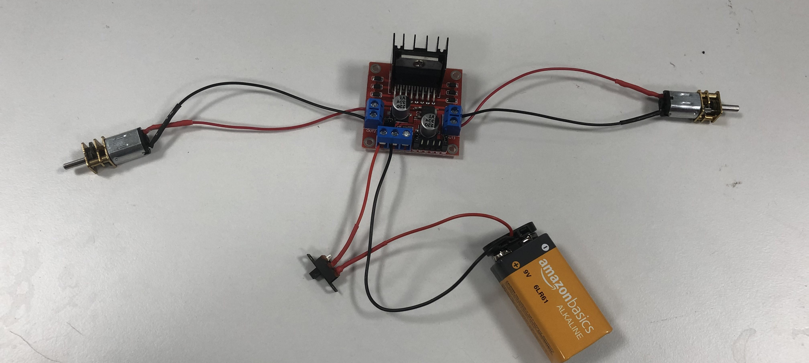
Drive base electronics

Slide 13
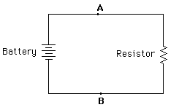
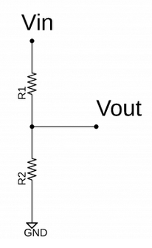
Resistors
V = IR
Current flows from high to low potentials
Uses in robotics:
Current limiting for LEDs
Pullup and pulldown resistors
Potential dividers
Sensors (e.g. LDRs thermistors etc)

Slide 14
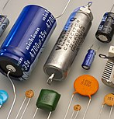
Capacitor
Stores charge
Can release a large charge in a very short amount of time

Slide 15

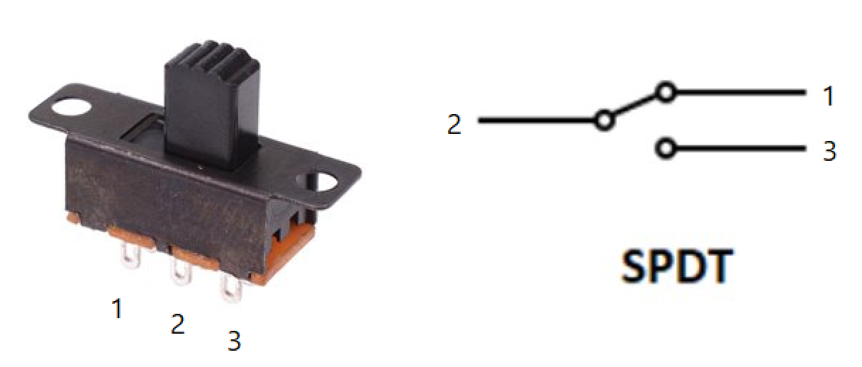
Switches & Buttons
Switch connects two contacts and completes a circuit.
This allows current to flow.
Transistors are switches that can be controlled electronically

Slide 16
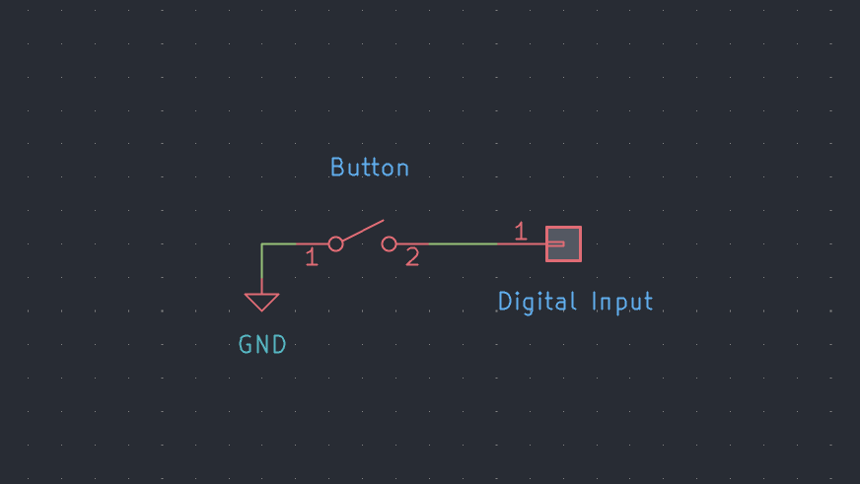

Slide 17
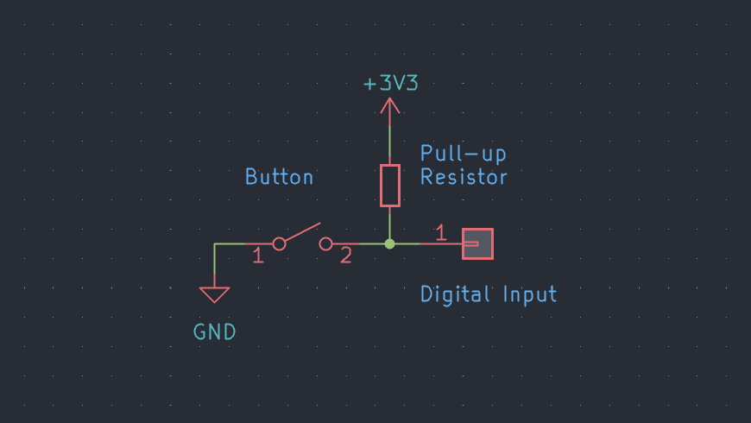

Slide 18
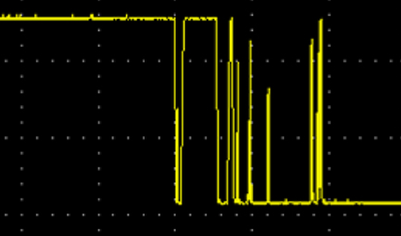

Slide 19
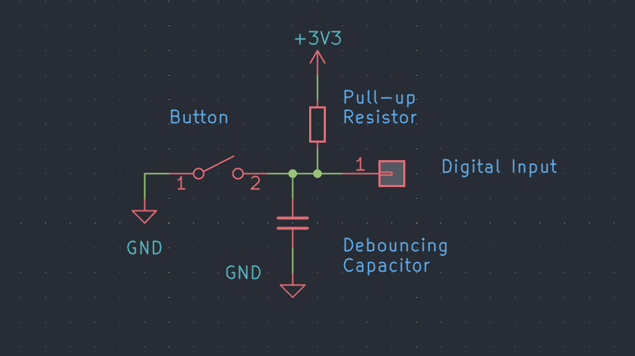

Slide 20
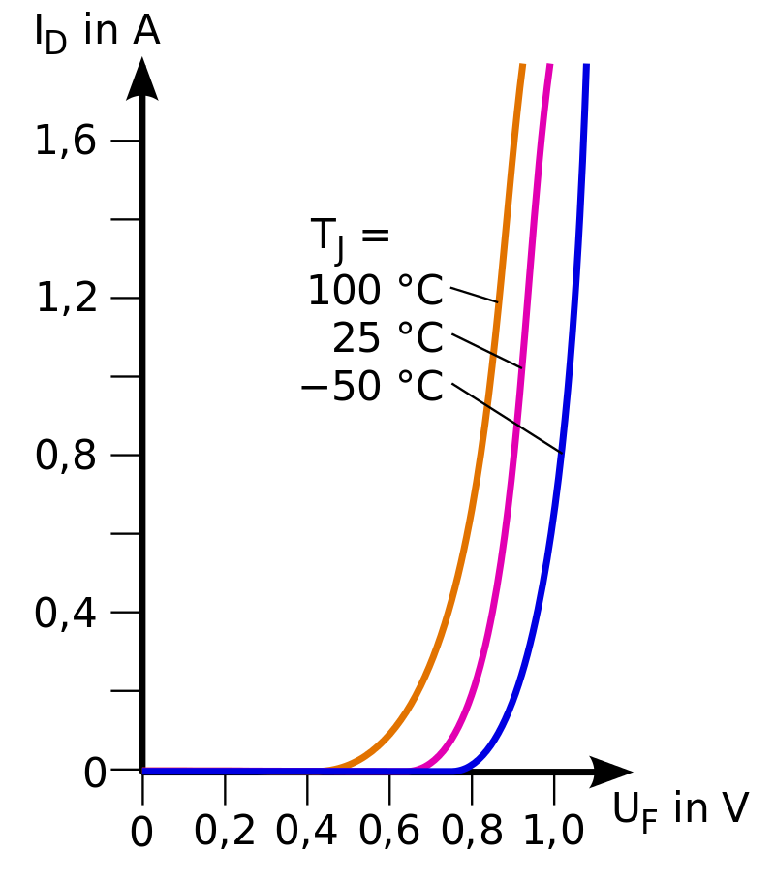
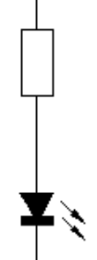
LEDs
Emit light when a voltage is put across them (in the correct orientation).
Non-linear so will explode if large voltage across them (show IV graph).
Solution is to put a resistor in series which limits the current.

Slide 21
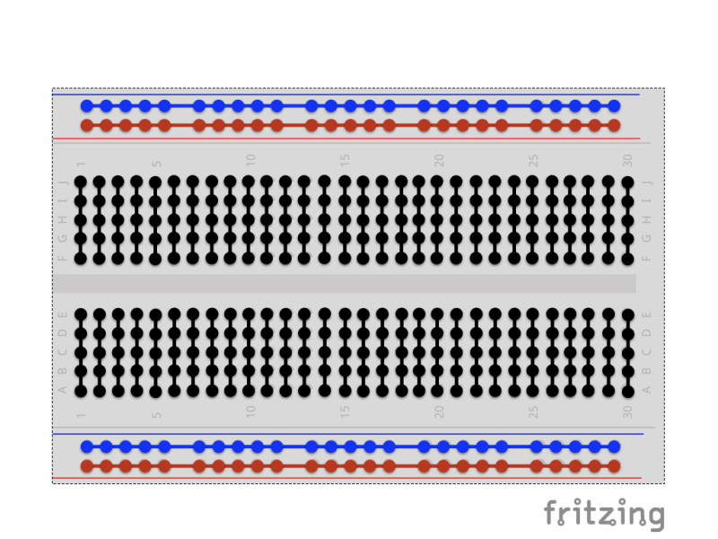
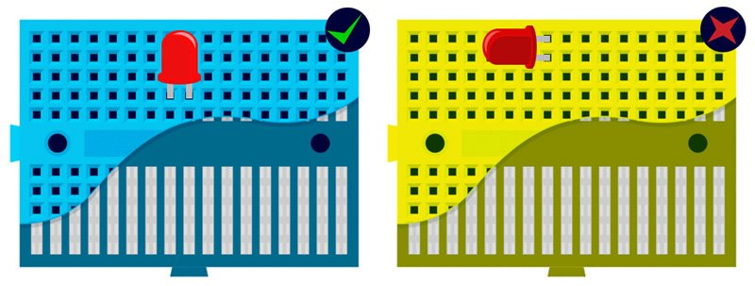
Breadboards
Holds and connects components
Used to prototype circuits with non-permanent connections

Slide 22
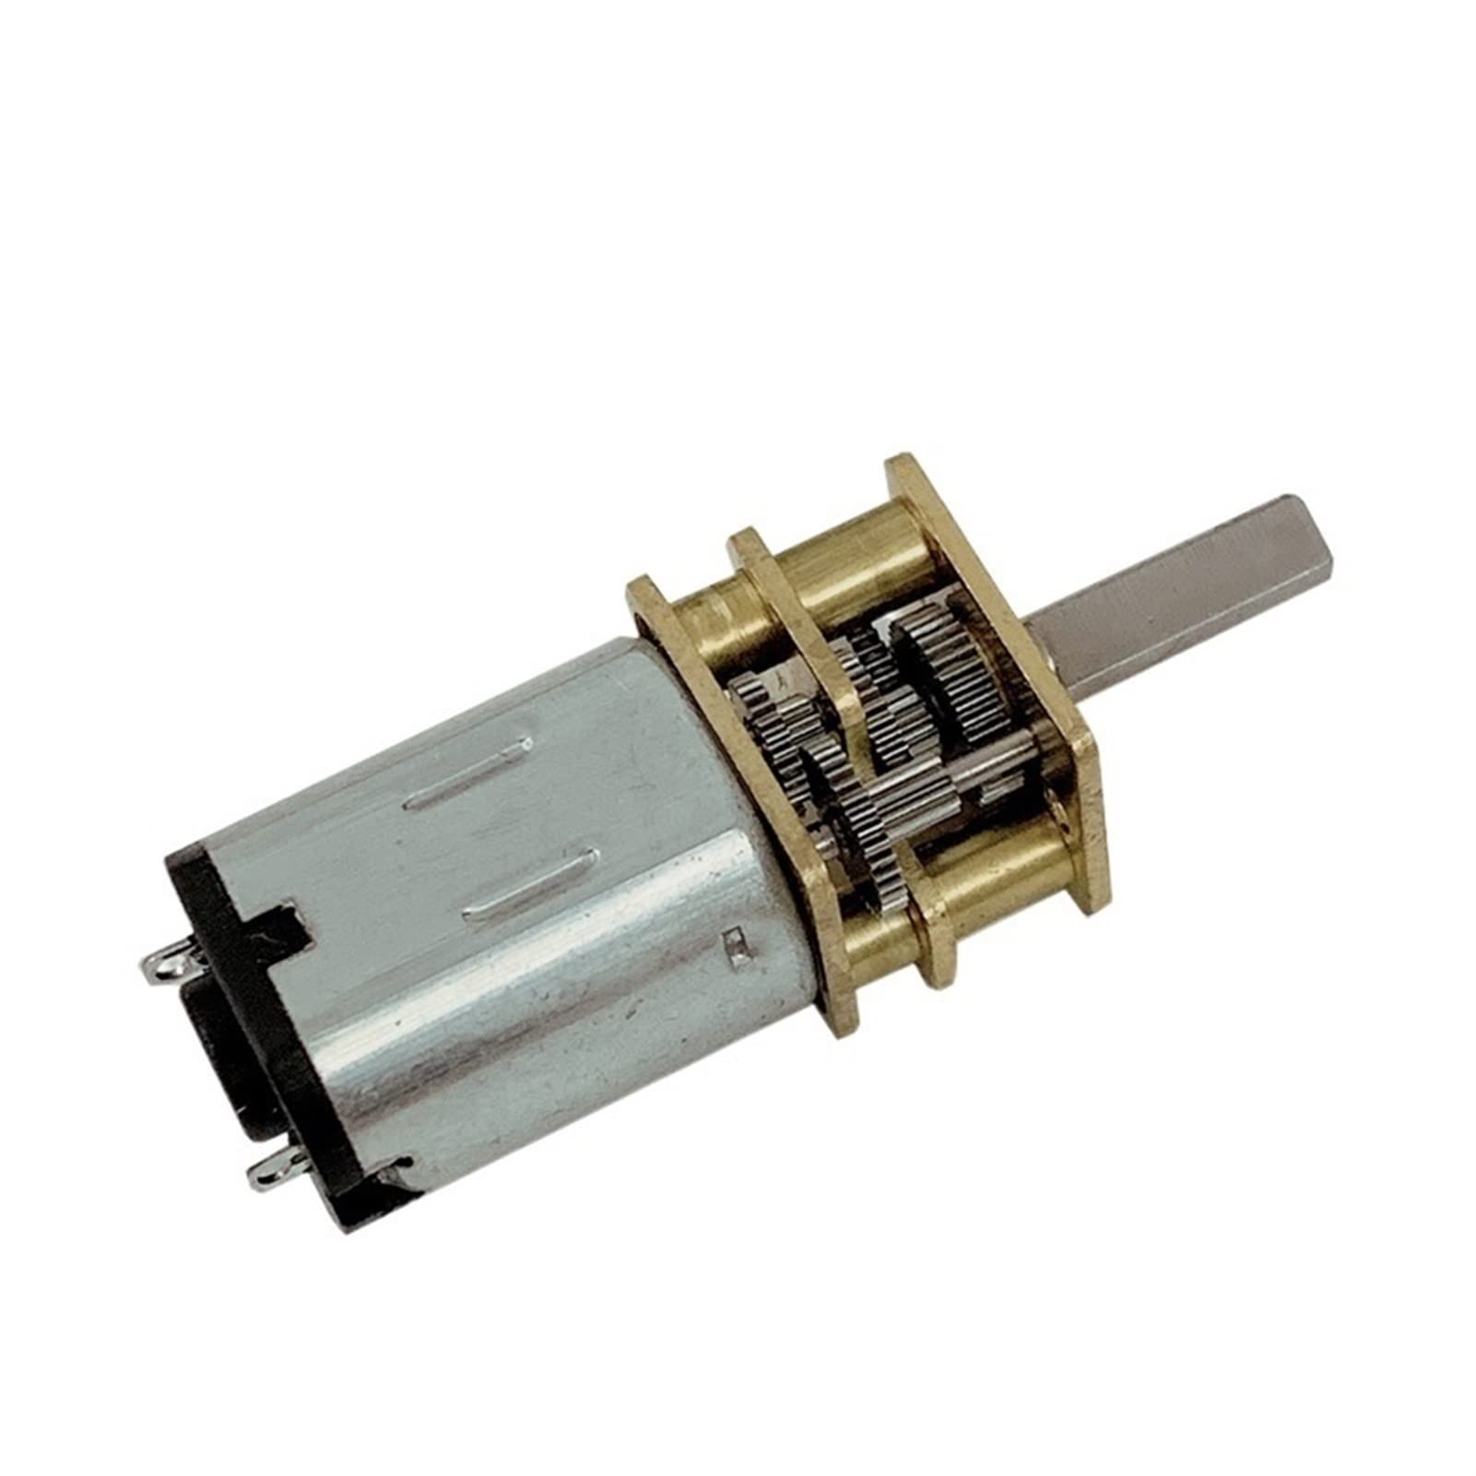
Motors
Effectively a big resistor.
Direction of current determines direction motor will spin.
Power dissipated using P = IV determines speed.

Slide 23
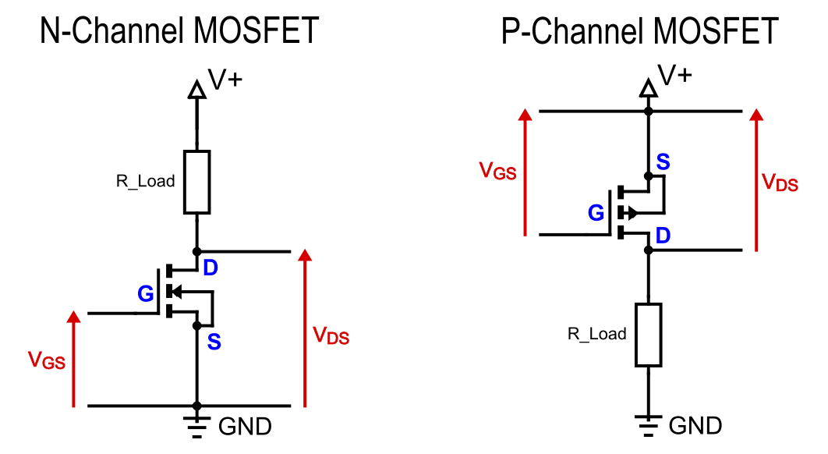
MOSFET
Metal Oxide Semiconductor Field Effect Transistor
VGS Threshold > 0
VGS Threshold < 0

Slide 24
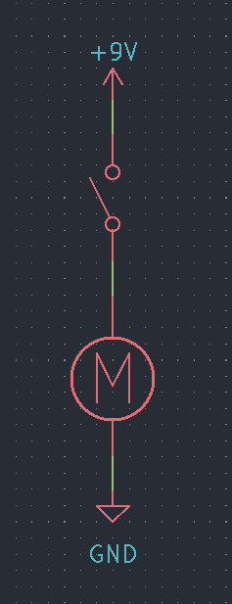
Motor Drivers - 1
Circuit with one switch: current can only flow one way so wheel can only turn one way.
Means no reversing and poor turning.

Slide 25
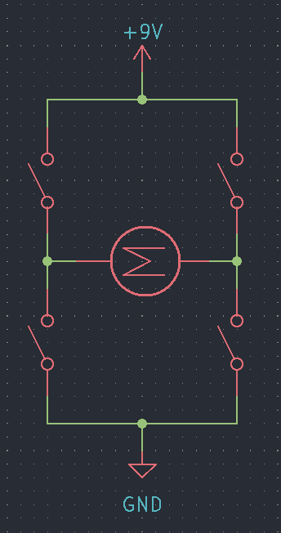
Motor Drivers – 2
H-bridge: 4 switches
Allows current to flow both ways through the motor if the right switches are closed.
Requires more control so this is typically handled by a chip.

Slide 26
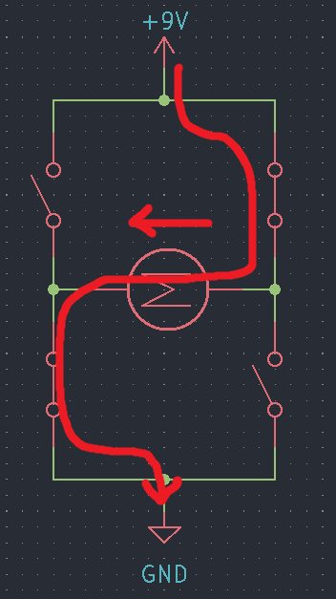
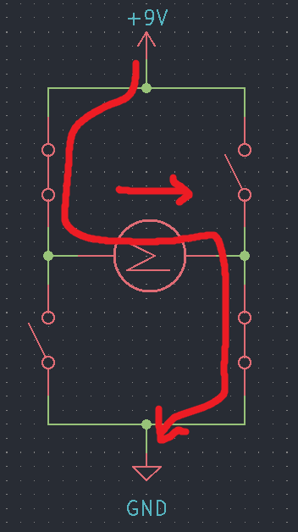

Slide 27
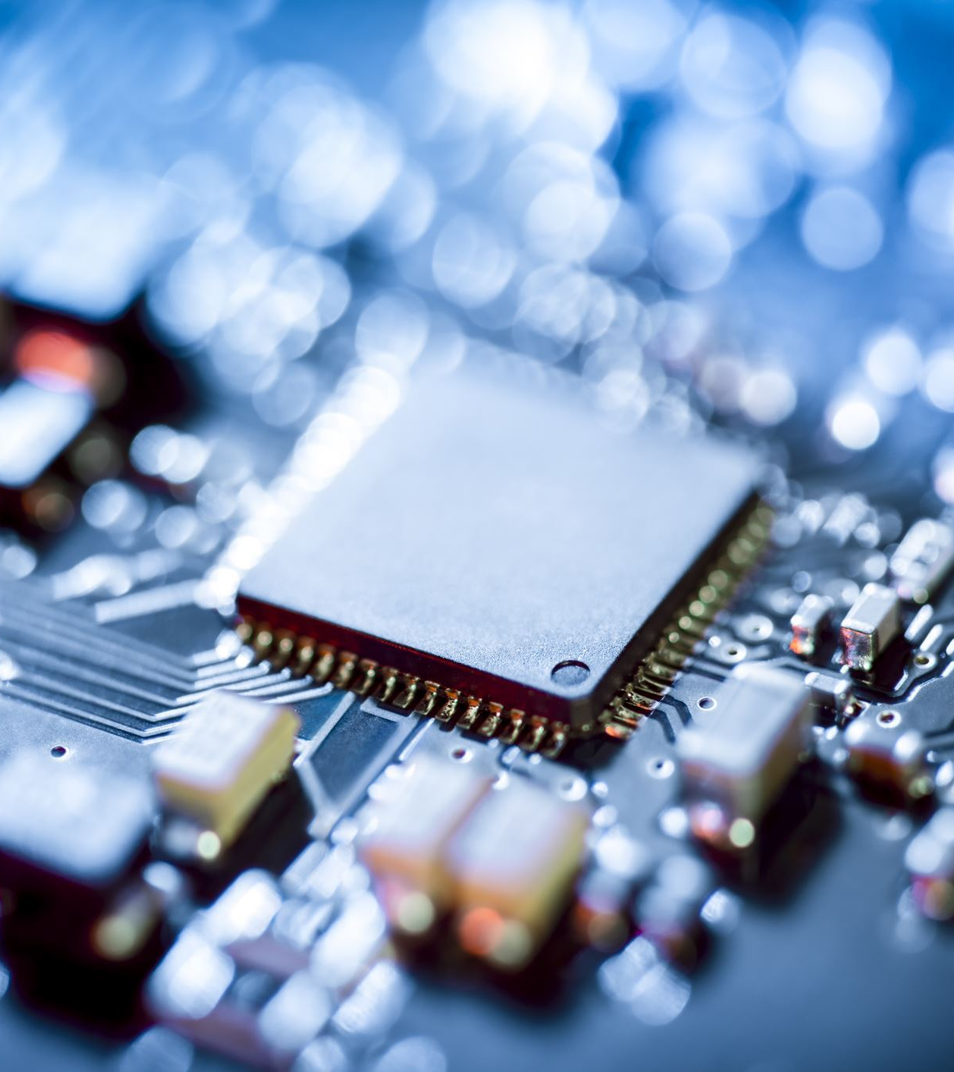
Microcontrollers
Tiny computers
Contain CPU, RAM, storage etc
Typically single or dual core
Run at tens to hundreds of megahertz
One hertz is approximately one instruction per second
Kilobytes of RAM and storage
Despite this, microcontrollers are often used with small operating systems, called real time operating systems.

Slide 28
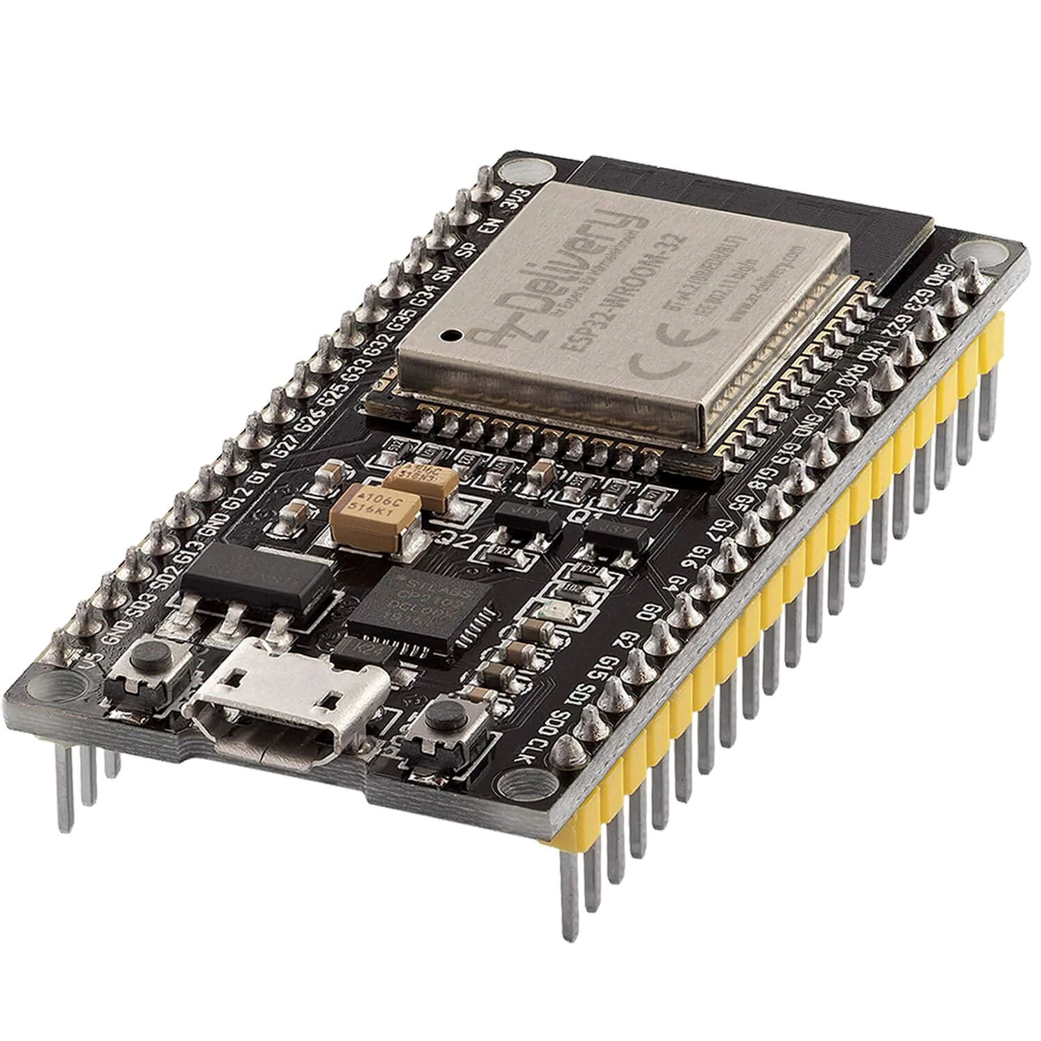
ESP32 - 1
Two 240MHz cores
4MB Flash
520KB RAM
Wi-Fi & Bluetooth

Slide 29
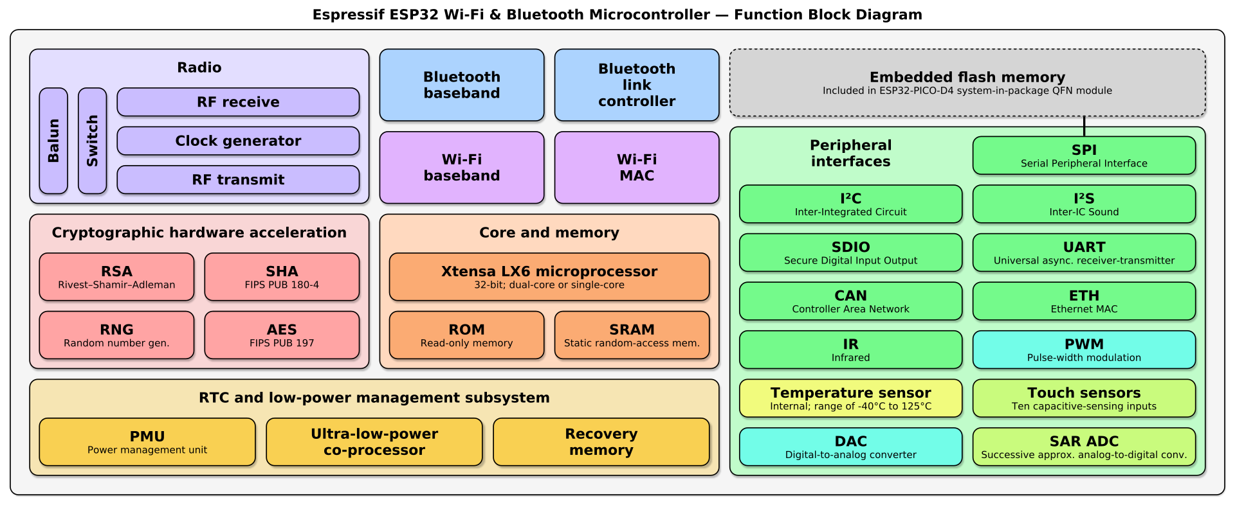
ESP32 - 2

Slide 30
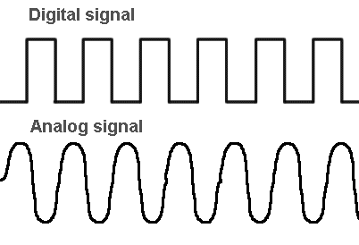
Digital IO
Digital means that there are two states: high or low which are expressed as voltages.
Typical voltages for high are 3.3V and 5V
Voltage for low is always 0V (ground)
The main way that microcontrollers interact with, and control electronics is by setting their pins to have a high or low voltage.
This can turn things on and off.
NOTE: These are logic voltages, and shouldn't be used to power anything

Slide 31
Motor Drivers – 3
Can now close switches
This allows the robot to go forwards, backwards and turn.
However, can only move at full speed.

Slide 32
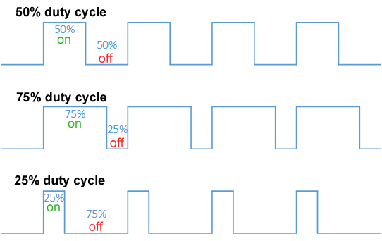
Pulse Width Modulation (PWM)
Turning on and off very fast
Duty cycle is the percentage of time the signal is high
Human eye flicker rate is 50-90Hz
However, ears can easily hear this.

Slide 33
Motor Drivers – 4
With PWM, robot can move at a variable speed
Better turning

Slide 34
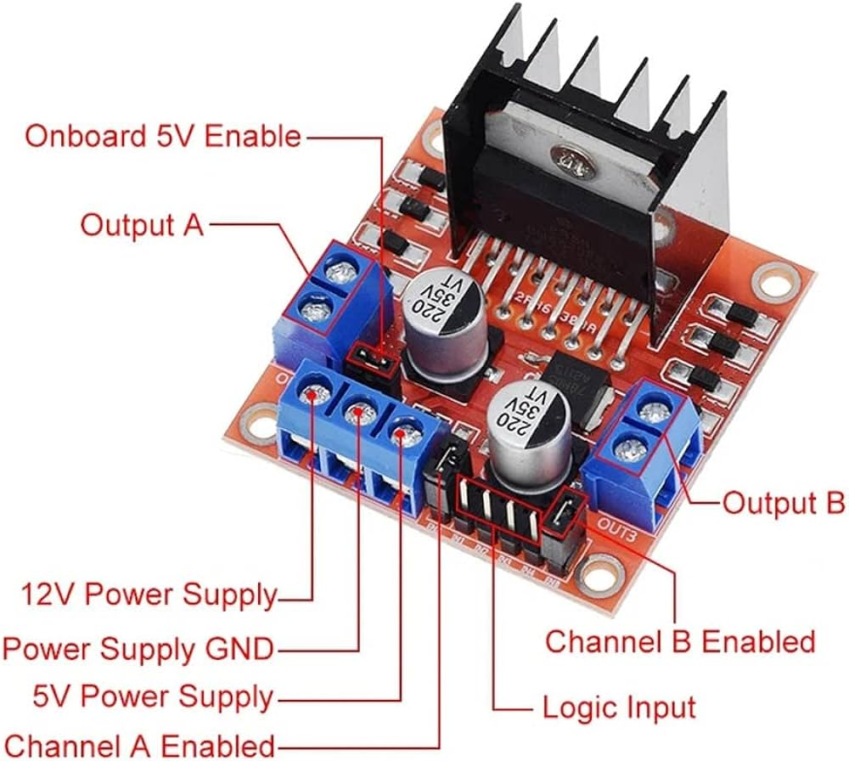

Slide 35
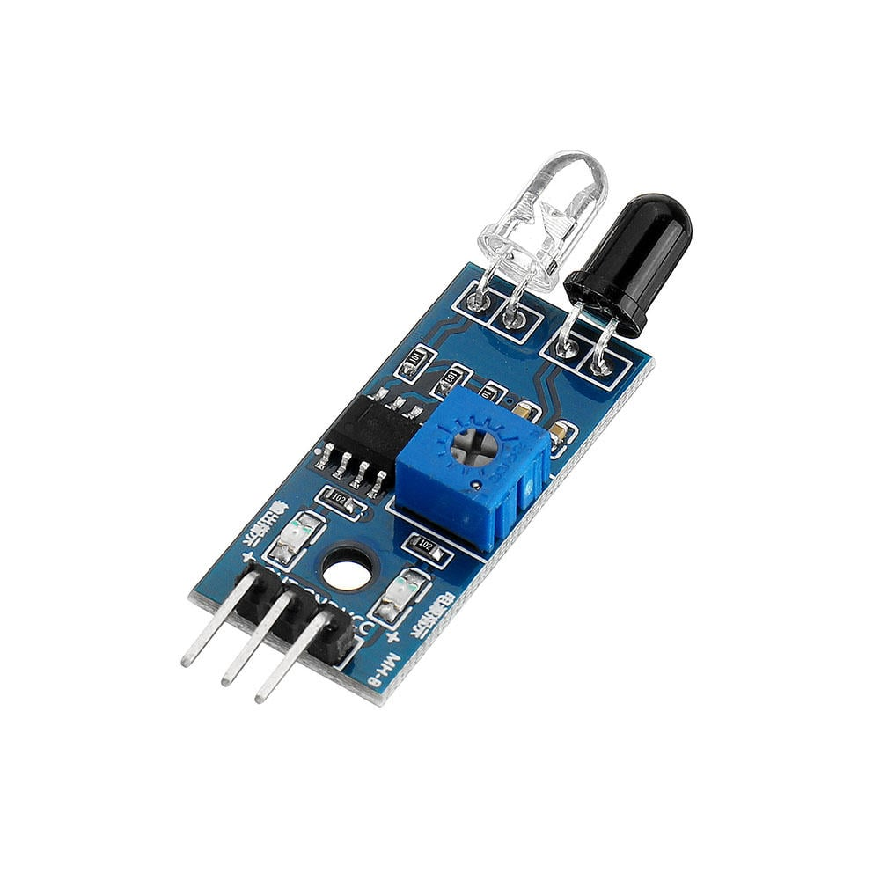
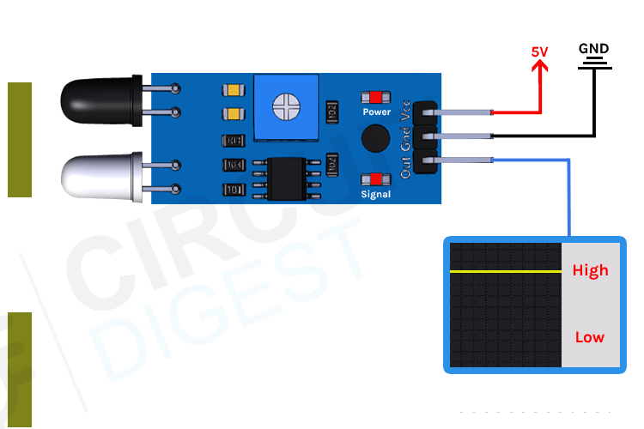
Sensors
So far, we've talked about outputting digital signals
Can also read both analogue and digital signals.
Typically from sensors:
E.g. IR Sensor, IMU

Slide 36
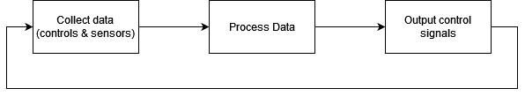

Slide 37

Questions

Slide 38



Software to download for next sessions
Fusion 360
QR code for educational licence
Arduino IDE

